Slide 1
Paraphrasing Lab Activities

Slide 2
Paraphrasing Paragraph 1
Of more than 1000 bicycling deaths each year, three-fourths are caused by head injuries. Half of those killed are school-age children. One study concluded that wearing a bike helmet can reduce the risk of head injury by 85 percent. In an accident, a bike helmet absorbs the shock and cushions the head. Taken from "Bike Helmets: Unused Lifesavers," Consumer Reports (Jack, 1990): 348.

Slide 3
Paraphrasing Paragraph 2
The Antarctic is the vast source of cold on our planet, just as the sun is the source of our heat, and it exerts tremendous control on our climate. Jacques Cousteau told the camera, "The cold ocean water around Antarctica flows north to mix with warmer water from the tropics, and its upwelling’s help to cool both the surface water and our atmosphere. Yet the fragility of this regulating system is now threatened by human activity." From "Captain Cousteau” by Carl Mark 1990 :17

Slide 4
Paraphrasing Paragraph 3
A strange series of events is associated with the creation of the Nobel Prize. Alfred Nobel invented dynamite in 1867. Nobel’s goal was to create a safer substance that would reduce accidental deaths among workers who are using explosives. It was soon used in war to kill and destroy. His invention had made him wealthy, and to make up for the devastation unleashed by his creation, Nobel sought a way to help humankind. He then decided to use his fortune to fund the Nobel Prizes, six international awards given annually for outstanding achievement in chemistry, literature, physics, physiology or medicine, economics, and promoting world peace. (Adapted from Alfred Richard, 2014.)

Slide 5
Rubric
Main Idea | Details | Paraphrasing | Spelling/ Punctuation | Grammar | References | Total
0 – 3 | 0 – 3 | 0 – 3 | 0 – 3 | 0 – 3 | 0 – 3 | 18

Slide 6
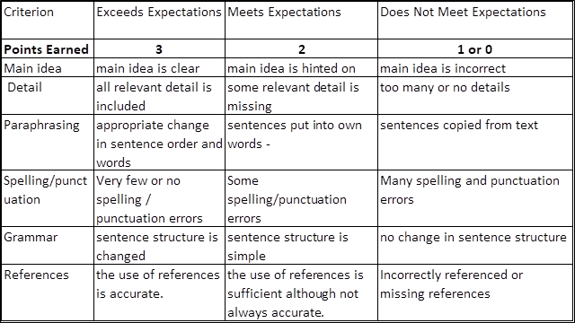
Detailed Rubric

